Slide 1
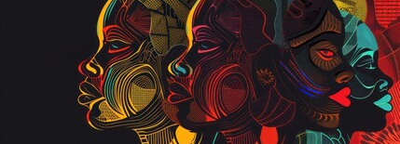
Patrimonio Cultural e Industrias Creativas para el Desarrollo Sostenible en África
Promoviendo el crecimiento a través de la cultura y la innovación
Abdourahamane Diallo, Coordinator Residente de la ONU en Congo
Notes:
---

Slide 2
La cultura como un pilar del desarrollo
Notes:
---
This slide references information from the following file: https://unesco-my.sharepoint.com/personal/c_ampah_unesco_org/_layouts/15/Doc.aspx?sourcedoc=%7BA8B243F5-74CE-4A2D-A905-067BF3D2451F%7D&file=Three%20Page%20Summary%20Cultural%20Heritage%20Africa.%20updatedocx.docx&action=default&mobileredirect=true
Culture as a Driver of Sustainable Development, Social Cohesion, Identity, and Peacebuilding

Slide 3
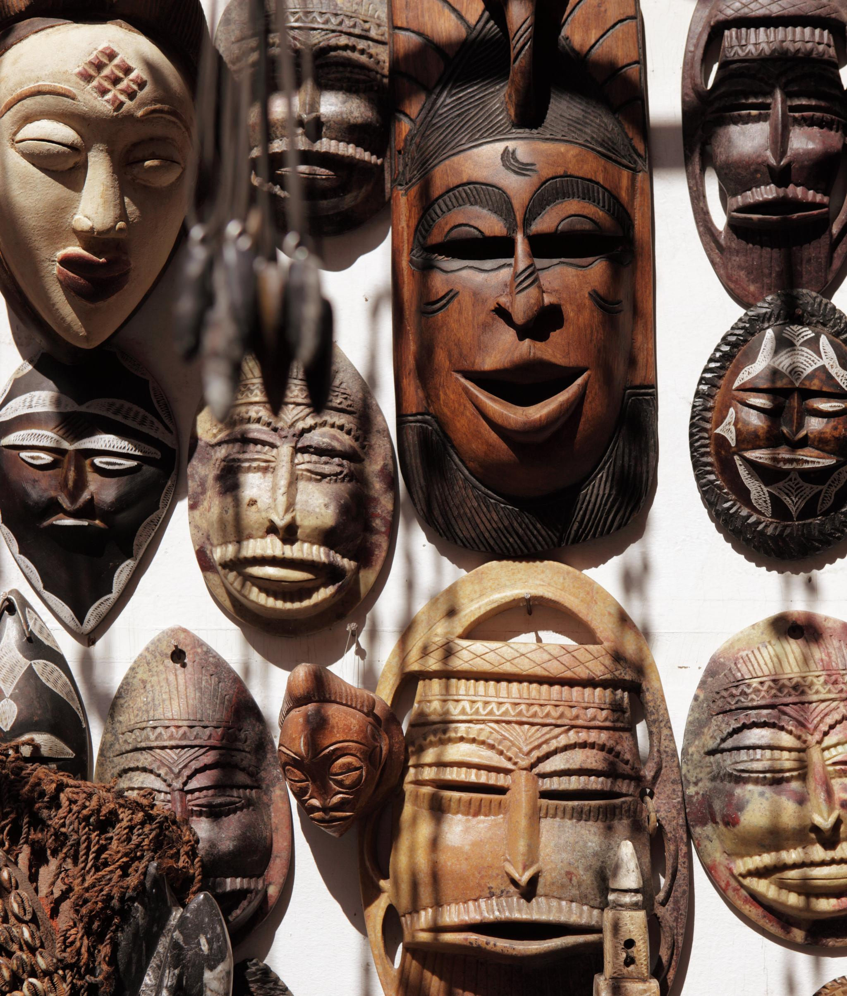
La Cultura como Motor Central del Desarrollo
La Cultura como Motor Central del Desarrollo
La cultura es reconocida globalmente como un fundamento para el crecimiento inclusivo, la construcción de la paz y la resiliencia.
Patrimonio Cultural y Creatividad Africana
La rica herencia y creatividad de África fomentan la cohesión social y empoderan a las comunidades económica y socialmente.
Beneficios Económicos y Sociales
Los sectores culturales como la música, la moda y los festivales generan empleos y promueven la preservación de la identidad en África.
Cultura y Objetivos de Desarrollo Sostenible
La integración de la cultura impulsa objetivos como la reducción de la pobreza, la educación, la igualdad de género y ciudades sostenibles.
Notes:
---
This slide references information from the following file: https://unesco-my.sharepoint.com/personal/c_ampah_unesco_org/_layouts/15/Doc.aspx?sourcedoc=%7BA8B243F5-74CE-4A2D-A905-067BF3D2451F%7D&file=Three%20Page%20Summary%20Cultural%20Heritage%20Africa.%20updatedocx.docx&action=default&mobileredirect=true
Culture is increasingly recognized as a core driver of sustainable development rather than a secondary or symbolic social sector. Globally, this shift was reinforced by UNESCO’s MONDIACULT Declaration, which positions culture as a global public good and a foundational pillar for inclusive growth, peacebuilding, and resilience. In the African context, culture plays a particularly critical role because of the continent’s rich heritage, youthful population, and strong traditions of creativity, storytelling, craftsmanship, and collective identity. Cultural heritage and creative expression support sustainable development by strengthening social cohesion, reinforcing shared values, and enabling communities to respond more effectively to economic, social, and environmental challenges.
One of the most important contributions of culture to development is its ability to generate economic value while preserving identity. Cultural practices such as music, film, fashion, crafts, festivals, and gastronomy are not only expressions of identity but also productive economic assets that create jobs and income. In many African countries, these sectors provide livelihoods for millions of people, particularly youth and women, who often face barriers in traditional labor markets. Culture also supports education and knowledge transmission by preserving indigenous knowledge systems related to agriculture, medicine, environmental management, and conflict resolution.
Furthermore, culture contributes directly to multiple Sustainable Development Goals, including poverty reduction, quality education, gender equality, decent work, reduced inequalities, sustainable cities, and peace and justice. When culture is integrated into national development strategies, it helps bridge economic growth with social inclusion and environmental sustainability. For Africa, recognizing culture as a development driver is essential for unlocking new pathways to prosperity that are rooted in local strengths rather than external dependency models. This foundational understanding sets the stage for exploring how creative industries, heritage protection, and cultural policies can collectively transform African economies and societies.
Illustrative image representing Africa’s cultural diversity, heritage symbols, and creative expression across the continent.

Slide 4
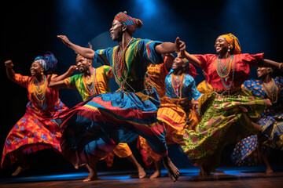
COHESIÓN SOCIAL, IDENTIDAD Y CONSTRUCCIÓN DE LA PAZ
Papel de la Cultura en la Cohesión Social
La cultura fomenta la cohesión social y la identidad al reforzar los valores compartidos y la memoria colectiva a través de las tradiciones y expresiones artísticas.
Protección del Patrimonio y Paz
Proteger el patrimonio cultural fortalece el sentido de pertenencia y la paz al prevenir la pérdida de identidad y la fragmentación social.
Cultura en la Resolución de Conflictos
El conocimiento indígena y la gobernanza tradicional complementan a las instituciones formales en el mantenimiento del orden social y la resolución de disputas.
Notes:
---
This slide references information from the following file: https://unesco-my.sharepoint.com/personal/c_ampah_unesco_org/_layouts/15/Doc.aspx?sourcedoc=%7BA8B243F5-74CE-4A2D-A905-067BF3D2451F%7D&file=Three%20Page%20Summary%20Cultural%20Heritage%20Africa.%20updatedocx.docx&action=default&mobileredirect=true
Beyond economics, culture plays a vital role in fostering social cohesion, identity, and peacebuilding across Africa. Many African societies are characterized by ethnic, linguistic, and religious diversity, which can be a source of strength but also a potential driver of tension when social bonds are weak. Cultural heritage, rituals, oral traditions, and artistic expression help reinforce shared values, collective memory, and mutual understanding among communities. These cultural elements provide platforms for dialogue, reconciliation, and healing, especially in post-conflict or fragile contexts such as parts of Central Africa and the Great Lakes region.
Heritage protection is increasingly linked to peace and resilience because the destruction or illicit trafficking of cultural property often contributes to identity loss and social fragmentation. When communities lose access to sacred sites, monuments, or traditional practices, the resulting erosion of identity can fuel grievances and instability. Conversely, protecting and revitalizing heritage can strengthen a sense of belonging and continuity, which is essential for long-term peace. Cultural initiatives such as community museums, festivals, and storytelling programs are often used to promote intergenerational learning and intercultural dialogue.
Culture also supports informal governance systems and conflict resolution mechanisms rooted in indigenous knowledge. Traditional councils, customary laws, and community rituals often play a complementary role to formal institutions in maintaining social order and resolving disputes. By recognizing and supporting these systems, development actors can enhance local ownership and legitimacy. In this way, culture is not only a reflection of society but also an active tool for building trust, resilience, and peaceful coexistence across diverse African communities.
Image depicting community gatherings, traditional ceremonies, and cultural performances that promote unity and peace.

Slide 5
Industrias creativas y transformación económica
Notes:
---
This slide references information from the following file: https://unesco-my.sharepoint.com/personal/c_ampah_unesco_org/_layouts/15/Doc.aspx?sourcedoc=%7BA8B243F5-74CE-4A2D-A905-067BF3D2451F%7D&file=Three%20Page%20Summary%20Cultural%20Heritage%20Africa.%20updatedocx.docx&action=default&mobileredirect=true
Economic Contribution of Creative Industries, Case Study: Film and Audiovisual Industries, Case Study: Music and Afrobeats as Cultural Exports

Slide 6
Contribución Económica de las Industrias Creativas
Impacto Económico Global
Las industrias creativas generan $2,25 billones anualmente y contribuyen de manera significativa al PIB global y al empleo.
Economía Creativa Africana
Los sectores creativos en África proporcionan empleo informal y ofrecen un crecimiento escalable más allá de las industrias extractivas.
Empoderamiento mediante Plataformas Digitales
Las plataformas digitales permiten a los creadores africanos alcanzar audiencias globales y monetizar productos culturales de manera efectiva.
Beneficios Intersectoriales
Las industrias creativas impulsan el turismo, la educación, la tecnología y el desarrollo urbano a través de inversiones culturales.
Notes:
---
This slide references information from the following file: https://unesco-my.sharepoint.com/personal/c_ampah_unesco_org/_layouts/15/Doc.aspx?sourcedoc=%7BA8B243F5-74CE-4A2D-A905-067BF3D2451F%7D&file=Three%20Page%20Summary%20Cultural%20Heritage%20Africa.%20updatedocx.docx&action=default&mobileredirect=true
Cultural and creative industries are among the fastest-growing sectors of the global economy, generating approximately US$2.25 trillion annually and employing millions of people worldwide. UNESCO estimates that these industries account for 3.1% of global GDP and 6.2% of global employment, with particularly strong participation from young people aged 18 to 25. For Africa, this represents a major opportunity to diversify economies that are often heavily dependent on extractive industries or agriculture. Creative sectors such as music, film, fashion, crafts, publishing, gaming, and digital arts offer scalable, innovation-driven growth pathways.
In many African countries, creative industries already operate as significant informal employers, providing income for artists, designers, performers, technicians, and small entrepreneurs. With improved policy frameworks, access to finance, and infrastructure, these activities can be formalized and expanded, increasing tax revenues and social protection coverage. The rise of digital platforms has further accelerated growth by enabling African creators to reach global audiences without traditional intermediaries. Streaming services, e-commerce platforms, and social media have transformed how African cultural products are produced, distributed, and monetized.
Importantly, creative industries also generate positive spillover effects across other sectors, including tourism, education, technology, and urban development. Cities that invest in cultural infrastructure and creative ecosystems often attract talent, investment, and innovation. By recognizing creative industries as a strategic economic sector, African governments can unlock new sources of growth that are inclusive, resilient, and aligned with local cultural strengths.
Visual representation of creative economic activities such as design, music production, fashion workshops, and digital content creation.

Slide 7
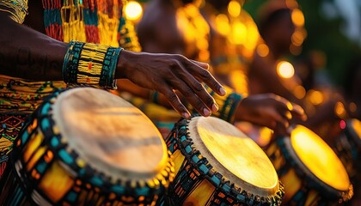
Estudio de caso: La música y los afrobeats como exportaciones culturales
Ascenso Global del Afrobeats
El Afrobeats, originario de Nigeria y Ghana, se ha convertido en un género global que influye en la música, la moda y la cultura en todo el mundo.
Impacto de las Plataformas Digitales
La transmisión digital y las redes sociales han reducido las barreras y ampliado el alcance global para los músicos africanos.
Beneficios Económicos y Culturales
El Afrobeats genera ingresos significativos y sirve como poder blando, remodelando la percepción global de África.
Desafíos en la Industria Musical
Cuestiones como la protección de la propiedad intelectual y la compensación justa a los artistas siguen siendo desafíos dentro de la industria.
Notes:
---
This slide references information from the following file: https://unesco-my.sharepoint.com/personal/c_ampah_unesco_org/_layouts/15/Doc.aspx?sourcedoc=%7BA8B243F5-74CE-4A2D-A905-067BF3D2451F%7D&file=Three%20Page%20Summary%20Cultural%20Heritage%20Africa.%20updatedocx.docx&action=default&mobileredirect=true
The African music industry, particularly the global rise of Afrobeats, highlights the export potential of creative industries. Originating primarily from Nigeria and Ghana, Afrobeats has evolved into a global genre influencing music, fashion, and popular culture across Africa, Europe, the Americas, and the diaspora. Between 2017 and 2022, Afrobeats streams on Spotify increased by approximately 550%, reflecting rapid international growth and expanding digital audiences. Nigeria’s music industry alone is estimated to generate around US$600 million annually.
Afrobeats illustrates how digital platforms can lower entry barriers for African artists while amplifying global reach. Artists collaborate across borders, leverage social media for marketing, and monetize through streaming, live performances, brand partnerships, and merchandising. Cultural hubs such as Lagos, Accra, and diaspora cities like London play a critical role in this ecosystem. However, challenges remain around intellectual property protection, royalty collection, and fair compensation for artists.
As a cultural export, Afrobeats also functions as a form of soft power, reshaping global perceptions of Africa and strengthening cultural diplomacy. By supporting music infrastructure, copyright systems, and regional touring networks, African countries can maximize both the economic and cultural benefits of this rapidly growing sector.
Image showing live music performances, recording studios, and African artists engaging global audiences.

Slide 8
Patrimonio, Turismo y Desarrollo Urbano
Notes:
---
This slide references information from the following file: https://unesco-my.sharepoint.com/personal/c_ampah_unesco_org/_layouts/15/Doc.aspx?sourcedoc=%7BA8B243F5-74CE-4A2D-A905-067BF3D2451F%7D&file=Three%20Page%20Summary%20Cultural%20Heritage%20Africa.%20updatedocx.docx&action=default&mobileredirect=true
Cultural Heritage and Sustainable Tourism, Culture-Led Urban Development and Creative Cities

Slide 9
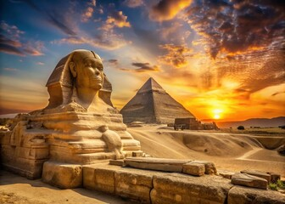
Patrimonio Cultural y Turismo Sostenible
El rico patrimonio de África
África alberga 139 sitios del Patrimonio Mundial de la UNESCO, incluyendo ciudades históricas y paisajes culturales que atraen a visitantes de todo el mundo.
Experiencias culturales
El patrimonio intangible como la música, la danza, la artesanía y las tradiciones orales ofrece experiencias auténticas para los turistas culturales.
Turismo comunitario sostenible
El turismo basado en la comunidad apoya las economías locales involucrando a los habitantes y preservando el patrimonio cultural de manera sostenible.
Desafíos del turismo sostenible
La planificación y la inversión son vitales para evitar la sobre comercialización y proteger los recursos culturales y ambientales.
Notes:
---
This slide references information from the following file: https://unesco-my.sharepoint.com/personal/c_ampah_unesco_org/_layouts/15/Doc.aspx?sourcedoc=%7BA8B243F5-74CE-4A2D-A905-067BF3D2451F%7D&file=Three%20Page%20Summary%20Cultural%20Heritage%20Africa.%20updatedocx.docx&action=default&mobileredirect=true
Africa’s rich cultural heritage offers substantial opportunities for sustainable tourism and local economic development. The continent is home to 139 UNESCO World Heritage properties, including historic towns, cultural landscapes, archaeological sites, and monuments such as the forts and castles of Ghana and Senegal. In addition, Africa possesses extensive intangible heritage, including music, dance, craftsmanship, rituals, and oral traditions that attract visitors seeking authentic cultural experiences.
Heritage-based tourism can generate income for local communities by stimulating demand for hospitality services, guides, crafts, gastronomy, and cultural performances. When managed sustainably, it encourages community participation, protects heritage assets, and supports small and medium-sized enterprises. Community-based tourism models are particularly effective because they ensure that economic benefits remain at the local level while reinforcing stewardship of cultural resources.
However, sustainable tourism requires careful planning to avoid over-commercialization, environmental degradation, and cultural exploitation. Investment in infrastructure, capacity building, and heritage conservation is essential. By integrating cultural heritage into national tourism strategies, African countries can create resilient tourism ecosystems that balance economic growth with preservation and social inclusion.
Image featuring heritage sites, museums, and cultural tourism activities across Africa.

Slide 10
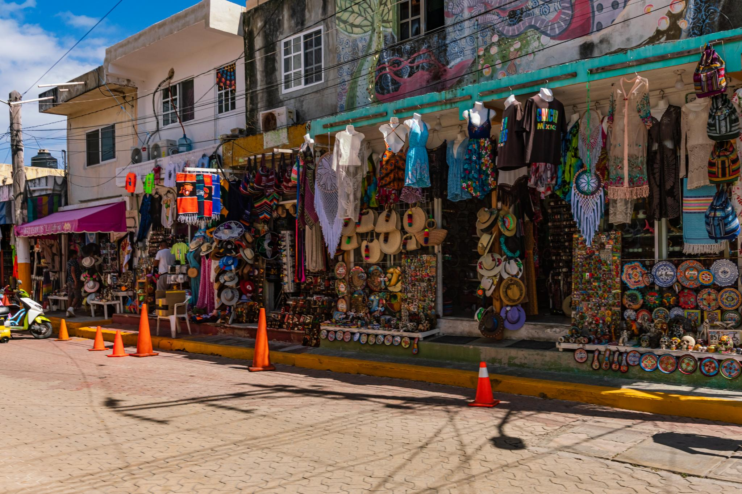
Desarrollo Urbano Liderado por la Cultura y Ciudades Creativas
Revitalización urbana a través de la cultura
El desarrollo impulsado por la cultura revitaliza las ciudades al atraer inversiones y fomentar la innovación en los entornos urbanos.
Centros creativos y colaboración
Los centros creativos y distritos culturales fomentan la colaboración entre artistas, emprendedores y tecnólogos en ciudades africanas.
Inversión en infraestructura cultural
Invertir en museos, teatros y galerías mejora la calidad de vida y fortalece la imagen de la ciudad.
Inclusión social y regeneración
La regeneración impulsada por la cultura promueve la inclusión social al recuperar espacios descuidados y empoderar a comunidades marginadas.
Notes:
---
This slide references information from the following file: https://unesco-my.sharepoint.com/personal/c_ampah_unesco_org/_layouts/15/Doc.aspx?sourcedoc=%7BA8B243F5-74CE-4A2D-A905-067BF3D2451F%7D&file=Three%20Page%20Summary%20Cultural%20Heritage%20Africa.%20updatedocx.docx&action=default&mobileredirect=true
Culture-led urban development has emerged as an effective strategy for revitalizing cities, attracting investment, and fostering innovation. Across Africa, cities such as Dakar, Lagos, Kigali, Kinshasa, and Brazzaville are leveraging creative industries, festivals, public art, and cultural spaces to transform urban environments. Creative hubs, co-working spaces, and cultural districts provide platforms for collaboration among artists, entrepreneurs, and technologists.
Investment in cultural infrastructure, including museums, theaters, galleries, and public cultural spaces, enhances quality of life while strengthening city branding. These initiatives attract tourism and skilled talent, particularly young people seeking vibrant, inclusive urban environments. UNESCO’s Creative Cities Network supports cities that prioritize creativity as a driver of sustainable urban development, encouraging knowledge exchange and international visibility.
Culture-led regeneration also promotes social inclusion by reclaiming neglected spaces and creating opportunities for marginalized communities. When aligned with urban planning and economic policy, cultural initiatives can contribute to sustainable cities that are resilient, innovative, and socially cohesive.
Image illustrating creative urban spaces, festivals, and revitalized cultural districts in African cities.

Slide 11
Marcos de Políticas, Oportunidades y el Camino a Seguir
Notes:
---
This slide references information from the following file: https://unesco-my.sharepoint.com/personal/c_ampah_unesco_org/_layouts/15/Doc.aspx?sourcedoc=%7BA8B243F5-74CE-4A2D-A905-067BF3D2451F%7D&file=Three%20Page%20Summary%20Cultural%20Heritage%20Africa.%20updatedocx.docx&action=default&mobileredirect=true
UNESCO Frameworks and Cultural Governance, AfCFTA, Opportunities, and Strategic Conclusion

Slide 12

Marcos de la UNESCO y Gobernanza Cultural
Convenciones Culturales de la UNESCO : Las convenciones de la UNESCO protegen el patrimonio cultural y promueven la diversidad para integrar la cultura en el desarrollo sostenible.
Marco de Indicadores Cultura 2030 : Este marco ayuda a los países a evaluar el impacto de la cultura en la prosperidad, la resiliencia, la inclusión y la sostenibilidad mediante datos sólidos.
Otro Apoyo de la ONU: OMPI, UNCTAD, PNUD, UNICEF, UNFPA apoyan colectivamente la economía creativa de África mediante la protección de la propiedad intelectual, el comercio creativo, el emprendimiento, el empoderamiento juvenil, la inclusión social, el desarrollo de habilidades y las iniciativas de trabajo decente en los sectores cultural y creativo.
Desafíos en el Financiamiento Cultural: la financiación pública global para la cultura sigue siendo baja, lo que resalta la necesidad de defensa y reformas de gobernanza.
Participación y Oportunidades Africanas: Los países africanos están adoptando políticas culturales y sistemas de datos para aprovechar la cultura como un acelerador del desarrollo.
Notes:
---
This slide references information from the following file: https://unesco-my.sharepoint.com/personal/c_ampah_unesco_org/_layouts/15/Doc.aspx?sourcedoc=%7BA8B243F5-74CE-4A2D-A905-067BF3D2451F%7D&file=Three%20Page%20Summary%20Cultural%20Heritage%20Africa.%20updatedocx.docx&action=default&mobileredirect=true
UNESCO plays a central role in shaping global cultural governance through international conventions and policy frameworks that link culture with sustainable development. Key instruments include the 1972 World Heritage Convention, the 2003 Convention for the Safeguarding of Intangible Cultural Heritage, and the 2005 Convention on the Protection and Promotion of the Diversity of Cultural Expressions. These frameworks encourage countries to protect heritage, support creative industries, and integrate culture into development planning.
One of UNESCO’s key tools is the Culture 2030 Indicators framework, which helps countries measure culture’s contribution to prosperity, resilience, inclusion, and sustainability. Strong cultural statistics are essential for evidence-based policymaking and increased public investment. Several African countries, including Ghana, Kenya, Rwanda, Senegal, Morocco, and South Africa, are already participating in this process.
Despite progress, public funding for culture globally remains below 0.6% of GDP, highlighting the need for stronger advocacy and governance reforms. By adopting coherent cultural policies and improving data systems, African countries can better harness culture as a development accelerator.
Image representing UNESCO’s role in heritage protection, cultural policy, and international cooperation.

Slide 13
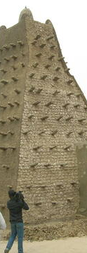

AfCFTA, Oportunidades y Conclusión Estratégica
AfCFTA Expande los Mercados Creativos
AfCFTA crea la mayor zona de libre comercio, expandiendo los mercados de música, cine, moda y servicios culturales en toda África.
Crecimiento en Sectores de Alto Impacto
Sectores como Nollywood, Afrobeats, moda y creatividad digital pueden aumentar las exportaciones y el empleo bajo el marco de AfCFTA.
Desafíos y Coordinación
Abordar el acceso a financiamiento, infraestructura digital, habilidades y propiedad intelectual requiere esfuerzos coordinados del gobierno y del sector privado.
Inversión Cultural Sostenible
Invertir de manera sostenible en los ecosistemas culturales impulsa el crecimiento inclusivo, la resiliencia, la construcción de paz y la prosperidad en África.
Notes:
---
This slide references information from the following file: https://unesco-my.sharepoint.com/personal/c_ampah_unesco_org/_layouts/15/Doc.aspx?sourcedoc=%7BA8B243F5-74CE-4A2D-A905-067BF3D2451F%7D&file=Three%20Page%20Summary%20Cultural%20Heritage%20Africa.%20updatedocx.docx&action=default&mobileredirect=true
The African Continental Free Trade Area (AfCFTA) presents a transformative opportunity for Africa’s cultural and creative industries. By creating the world’s largest free trade area by membership, AfCFTA can expand regional markets for music, film, fashion, publishing, crafts, gaming, and cultural services. It offers pathways to reduce market fragmentation, strengthen regional value chains, improve artist mobility, and harmonize intellectual property systems.
Under AfCFTA, high-growth sectors such as Nollywood, Afrobeats, fashion and textiles, digital creativity, and heritage tourism can scale across borders, increasing exports and job creation. However, realizing this potential requires addressing key challenges, including limited access to finance, weak digital infrastructure, skills gaps, and intellectual property vulnerabilities. Coordinated action by governments, the private sector, and international partners is essential.
The central conclusion is that Africa’s cultural and creative assets represent one of the continent’s most significant untapped economic frontiers. Moving beyond cultural preservation toward sustainable cultural investment ecosystems can drive inclusive growth, resilience, peacebuilding, and long-term prosperity. As UNESCO emphasizes, no development can be sustainable without culture.
Forward-looking image symbolizing Africa’s creative future, youth innovation, and cultural-led growth.

Slide 14
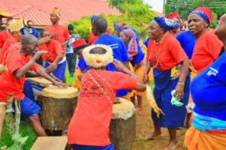
Oportunidades y Conclusión Estratégica
Las oportunidades estratégicas clave incluyen:
Utilizar iniciativas de arte y patrimonio para fortalecer la reconciliación, la cohesión social y la prevención de conflictos.
Apoyar incubadoras creativas, industrias digitales, cadenas de valor de artesanía y financiación del emprendimiento cultural para generar empleo juvenil.
Aprovechar el turismo ecocultural y los sistemas de conocimientos indígenas para el crecimiento verde y la conservación liderada por la comunidad.
Promover ciudades creativas, infraestructura cultural pública, festivales, museos y plataformas culturales digitales.
Fortalecer las estadísticas culturales y la formulación de políticas basada en evidencia para mejorar la inversión y la financiación.
Notes:
---
This slide references information from the following file: https://unesco-my.sharepoint.com/personal/c_ampah_unesco_org/_layouts/15/Doc.aspx?sourcedoc=%7BA8B243F5-74CE-4A2D-A905-067BF3D2451F%7D&file=Three%20Page%20Summary%20Cultural%20Heritage%20Africa.%20updatedocx.docx&action=default&mobileredirect=true
The African Continental Free Trade Area (AfCFTA) presents a transformative opportunity for Africa’s cultural and creative industries. By creating the world’s largest free trade area by membership, AfCFTA can expand regional markets for music, film, fashion, publishing, crafts, gaming, and cultural services. It offers pathways to reduce market fragmentation, strengthen regional value chains, improve artist mobility, and harmonize intellectual property systems.
Under AfCFTA, high-growth sectors such as Nollywood, Afrobeats, fashion and textiles, digital creativity, and heritage tourism can scale across borders, increasing exports and job creation. However, realizing this potential requires addressing key challenges, including limited access to finance, weak digital infrastructure, skills gaps, and intellectual property vulnerabilities. Coordinated action by governments, the private sector, and international partners is essential.
The central conclusion is that Africa’s cultural and creative assets represent one of the continent’s most significant untapped economic frontiers. Moving beyond cultural preservation toward sustainable cultural investment ecosystems can drive inclusive growth, resilience, peacebuilding, and long-term prosperity. As UNESCO emphasizes, no development can be sustainable without culture.
Forward-looking image symbolizing Africa’s creative future, youth innovation, and cultural-led growth.

Slide 15
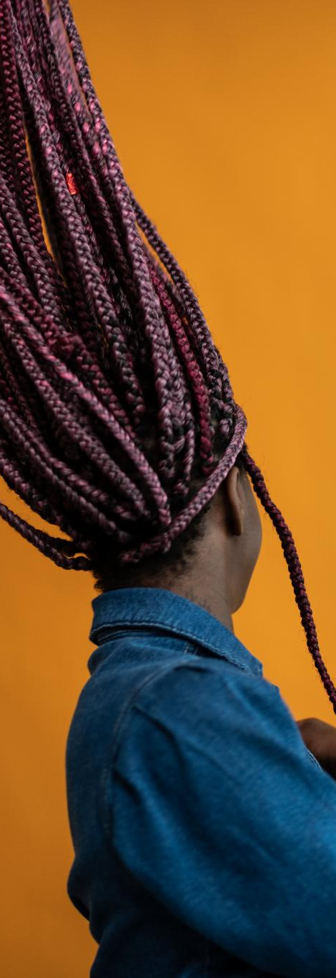
Oportunidades y Conclusión Estratégica
El mensaje más amplio es que la cultura ya no debe ser tratada como una actividad social periférica. En cambio, debe entenderse tanto como un sector de desarrollo como un habilitador de desarrollo capaz de impulsar el crecimiento inclusivo, la resiliencia, la innovación y la transformación estructural en toda África.
La conclusión central es que los activos culturales y creativos de África representan una de las fronteras económicas más significativas aún no explotadas del continente.
La próxima etapa de la política de desarrollo debería, por lo tanto, ir más allá de la simple preservación cultural hacia la construcción de ecosistemas de inversión cultural sostenibles que generen empleo, fortalezcan la resiliencia, apoyen la construcción de la paz y generen prosperidad a largo plazo.
“Ningún desarrollo puede ser sostenible sin cultura.” — UNESCO
Notes:
---
This slide references information from the following file: https://unesco-my.sharepoint.com/personal/c_ampah_unesco_org/_layouts/15/Doc.aspx?sourcedoc=%7BA8B243F5-74CE-4A2D-A905-067BF3D2451F%7D&file=Three%20Page%20Summary%20Cultural%20Heritage%20Africa.%20updatedocx.docx&action=default&mobileredirect=true
The African Continental Free Trade Area (AfCFTA) presents a transformative opportunity for Africa’s cultural and creative industries. By creating the world’s largest free trade area by membership, AfCFTA can expand regional markets for music, film, fashion, publishing, crafts, gaming, and cultural services. It offers pathways to reduce market fragmentation, strengthen regional value chains, improve artist mobility, and harmonize intellectual property systems.
Under AfCFTA, high-growth sectors such as Nollywood, Afrobeats, fashion and textiles, digital creativity, and heritage tourism can scale across borders, increasing exports and job creation. However, realizing this potential requires addressing key challenges, including limited access to finance, weak digital infrastructure, skills gaps, and intellectual property vulnerabilities. Coordinated action by governments, the private sector, and international partners is essential.
The central conclusion is that Africa’s cultural and creative assets represent one of the continent’s most significant untapped economic frontiers. Moving beyond cultural preservation toward sustainable cultural investment ecosystems can drive inclusive growth, resilience, peacebuilding, and long-term prosperity. As UNESCO emphasizes, no development can be sustainable without culture.
Forward-looking image symbolizing Africa’s creative future, youth innovation, and cultural-led growth.

